Slide 1
Jermyn Borough Council Meeting
2/20/20

Slide 2
Meeting Agenda
Call to Order
Pledge of Allegiance
Roll Call
Previous Meeting Minutes
Treasurer’s Report/Bills Payable
Correspondence
Public Comment
Official’s Reports
Reports of Commissions/Committees
Tax Collector
New Business
Adjournment

Slide 3
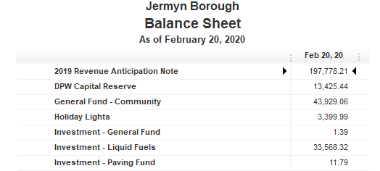
Treasurer’s report

Slide 4
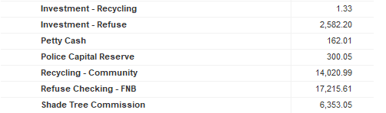
Treasurer’s report

Slide 5
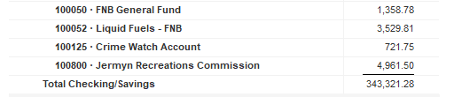
Treasurer’s report

Slide 6

Treasurer’s report

Slide 7
Meeting Agenda
Call to Order
Pledge of Allegiance
Roll Call
Previous Meeting Minutes
Treasurer’s Report/Bills Payable
Correspondence
Public Comment
Official’s Reports
Reports of Commissions/Committees
Tax Collector
New Business
Adjournment

